Slide 1





DEFAULTER ANALYSIS AND CLASSIFICATION FOR A MONEY LENDING COMPANY
NAME: HARSHIL PANDEY
ROLL NO: 22F1001864

Slide 2



Home Credit Group was founded in 1997 in the Czech Republic and as of 2024, it has major presence in Asian countries like Kazakhstan, China, India, Philippines, and Indonesia.
Home Credit Group is a financial company which aims to provide financial solutions to both individual customers and businesses which makes it a B2C as well as a B2B business.
About the Business
Services offered by Home Credit include personal loans, credit cards, home loans, and EMI based payments on products like mobile phones and home appliances.
The services are open to all types of customers but the main objective is to target customers with insufficient credit history who find it difficult to obtain credit from sources like reputed banks.

Slide 3
Problem Stament
Accurate defaulter classification: The company records huge number of customer attributes. Out of all the attributes, identifying the most important ones that lead to reliable classification is a challenge. Moreover, it has to be kept in mind that too many loans are not rejected.
Utilizing past data: Utilizing past data is also a major obstacle as not every customer has past data corresponding to them. Finding innovative ways to include such data into the analysis will be the main task.

Slide 4
application_train.csv:
Each row in this file corresponds to one application by a customer.
Contains the attributes related to the customers and the loan, recorded at the time of application.
Overview of Data
previous_application .csv:
Each row in this file corresponds to one previous loan application a customer made to the Home Credit Group.
bureau.csv:
Each row in this file corresponds to one previous loan application a customer made which was reported to the Credit Bureau.
The information given by other financial institutions.
credit_card_balance.csv:
This file contains the monthly records of the previous credit cards a customer had with the Home Credit Group.
Distributed in seven CSV files
bureau_balance.csv:
This file contains the monthly status records of the previous loans that were reported to the Credit Bureau.
installments_payments.csv:
Each row in this file corresponds to an instalment payment made or missed by the customer for a previous Home Credit loan.
POS_CASH_balance.csv:
This file contains the monthly snapshots of the previous loan applications that the customers had with the Home Credit Group.

Slide 5


Analysis Process and Approach
01
02
03
04
Initial Filtering Based on Descriptive Statistics
Standard Deviation
Box Plots
Null Values
Further Analysis on the Retained Attributes and Outlier Detection
Kernel Density Plot
Histogram of Default Percentage
Scaling and Imputing Null Values
Modified version of KNN Imputation.
Done in batches
Aggregating Past Data
Aggregate data based on unique loan ID using ‘groupby’ functionality in Python.
Perform same analysis on newly created features

Slide 6

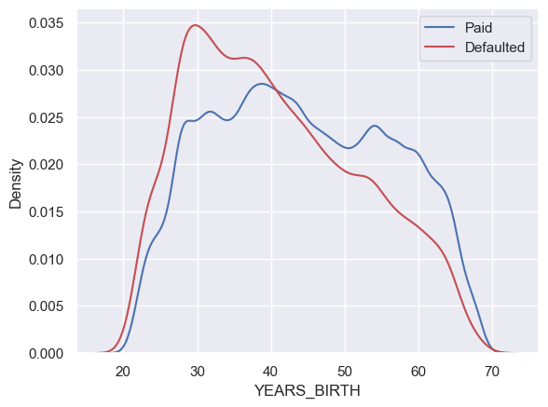
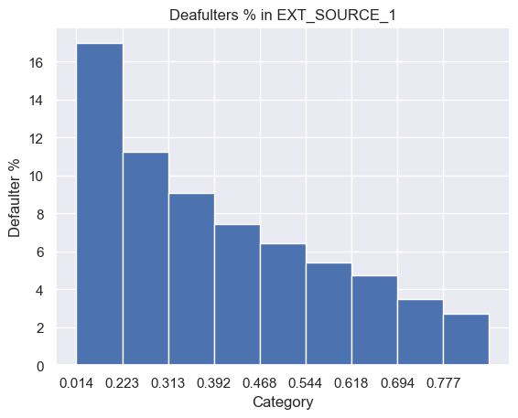
Results and Findings
‘YEARS_BIRTH’ represents the age of the customer.
It can be clearly seen that the density of defaulters is much higher for younger customer having age below 35 years.
As the age increases, the density of defaulters falls sharply.
‘EXT_SOURCE_1’ represents the credit score of the customer according to some external source.
The highest percentage of defaulters are among those who have a credit score less than 0.3.
Consistent decreasing trend between the feature and defaulter percentage.

Slide 7
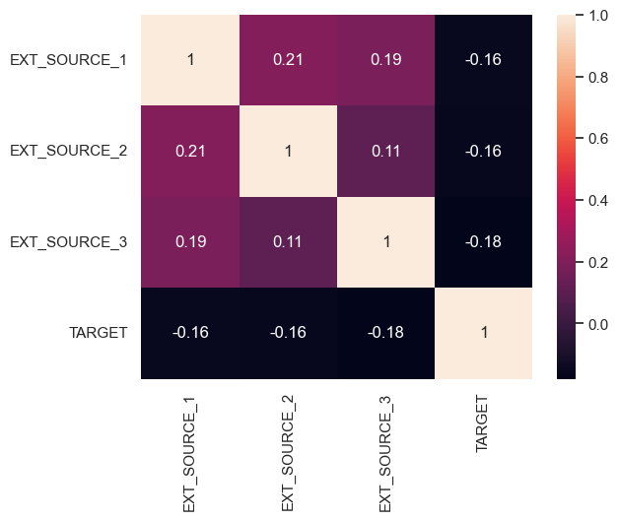
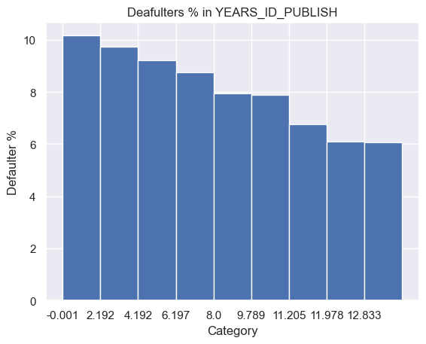
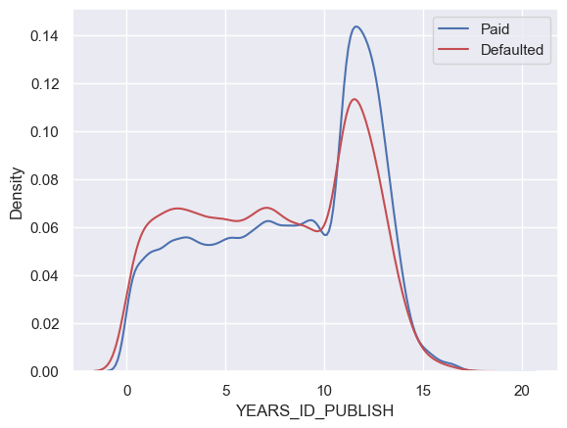
The heatmap reveals that all the external source scores are weakly correlated and are individually important.
All external sources show a weak negative correlation with the ‘TARGET’ attribute.
‘YEARS_ID_PUBLISH’ is the number of years before the application, the customer changed their ID.
The highest percentage of defaulters are among those who have a changed their ID less than two years ago.
Consistent decreasing trend between the feature and defaulter percentage.

Slide 8
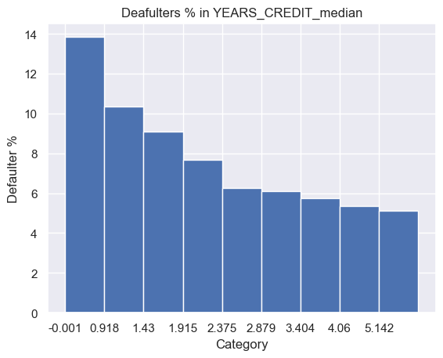
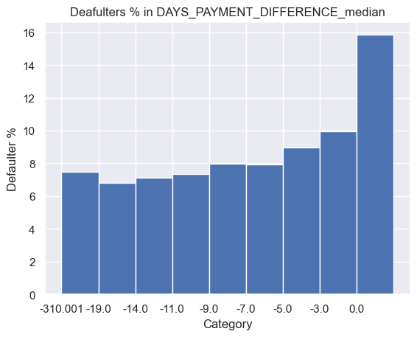
‘YEARS_CREDIT_MEDIAN’ represents the median number of years a customer applied for some other loan before applying to the current loan.
A sharp and consistent trend between the feature and the default percentage of customers.
Customers who had applied less than a year ago are the most likely to default.
‘DAYS_PAYMENT_DIFFERENCE-MEDIAN’ is the median number of days a customers pays their instalment relative to the due date.
Negative means that the customer pays early.
Positive means that the customer pays late.
The plot clearly shows that any customer that pays even a single day late is most likely to deafult.

Slide 9
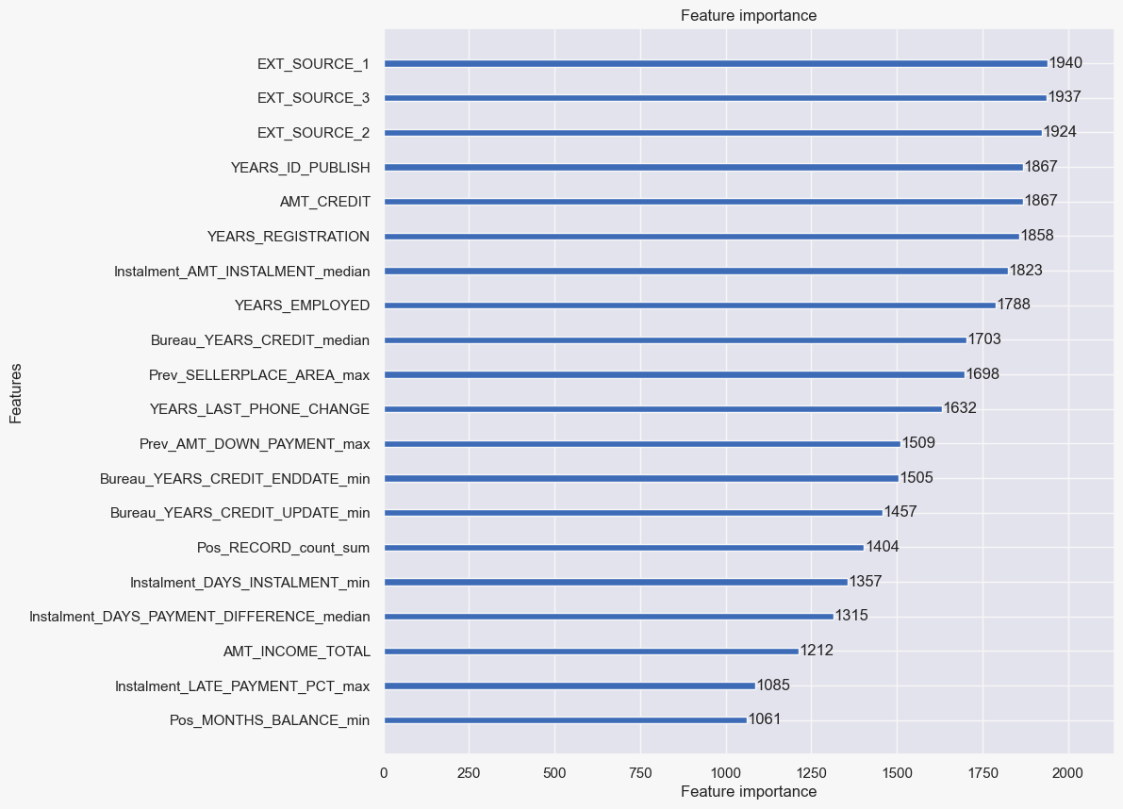

Feature Importance of each feature according to LightBGM classification model. The plot shows the top 20 most important features.

Slide 10
Interpretations and Recommandations
The age of the customer plays a major role in explaining their repayment behavior. Young clients with age less than 30 years are most likely to default while older clients with age over 45 years are comparatively less likely to default. This may be due to the fact that older individuals have more financial experience.
When the customer has recent ongoing or completed loans, they are more likely to default than a customer who had completed loans more than 2 years ago. This can be attributed to inability to pay all the ongoing instalments at once.
A customer that has had even a single late instalment payment in any of the loans in the past is twice more likely to default again in the current loan. Major reason can be their lack of credit management
The loan approval process has to be made more stringent especially for customers having age below 35 years, or, who have no or low external credit scores (below 0.5), or, who have various ongoing or recently completed loans (within a year), or, who have changed their personal ID recently (within 1.5 years), or, who have made late payments even once.
The unimportant variables should continue to be recorded as some important features have correlations with other features, this helps in imputing the values of these important features with the help of other features.
Personal Loans should be awarded after some down payment by the customer. Zero down payment option should only be given to those customers who have had previous loans with Home Credit with no late payments.

